Slide 1
Tuples and sets
Data structures

Slide 2



tuples
A tuple is a collection which is ordered and unchangeable
Tuples are written with round brackets.
Once a tuple is created, you cannot change its values. Tuples are unchangeable, or immutable
How to change? Convert tuple to list, change, then convert back

Slide 3
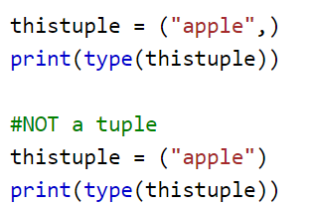
Tuple with one item – special case
This will be in the exam, because it’s strange

Slide 4
Tuples vs lists
If you have data which is not meant to be changed in the first place, you should choose tuple data type over lists.
E.g. the lat/lon of a building
E.g. the speed of light or other constants

Slide 5
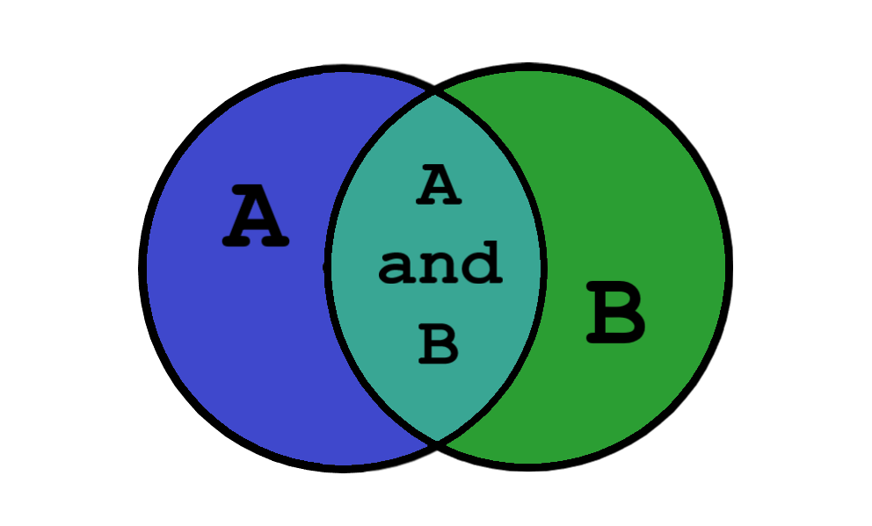
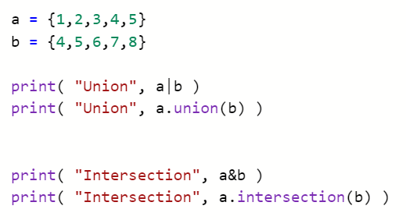
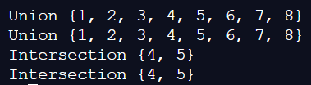
Python sets

Slide 6





Slide 7
Set uses in real life
Does a shop have an item?
Does it have all the items you wish to purchase?
Which students are in both maths and physics?

